Slide 1
Fake News Detection
Team members:
Madhavi Latha Parsa (16337164)
Lakshmi Tulasi Devagiri (14420344)
Tirupathi Reddy Devagiri (14420345)
Bhargav Reddy Ramasahayam (16336168)

Slide 2
BACKGROUND:
Social media is used for news reading.
Source of the news
professions used to distribute the news in the past.
now a days, everybody want to be a journalist.
People are profiting by clickbait’s and publishing fake news on online.
More clicks contribute to more money for content publishers.

Slide 3
INTRODUCTION:
Fake news exist method before from social media however it multifold once social media was introduced.
Fake news is a news designed to deliberately spread hoaxes, propagate and disinformation.
Fake news stories usually spread through social media sites like facebook, Twitter etc.
Here we are using a dataset as reference and applying logistic regression to predict whether the news is fake or real

Slide 4
Techniques and classification models used
→Different
→Stemming
→Data Visualization :
1. Word Count
2. Box Plot
3. Pie chart
→Logistic regression
→tfidfvectorizer

Slide 5
Flow of the Code

Slide 6
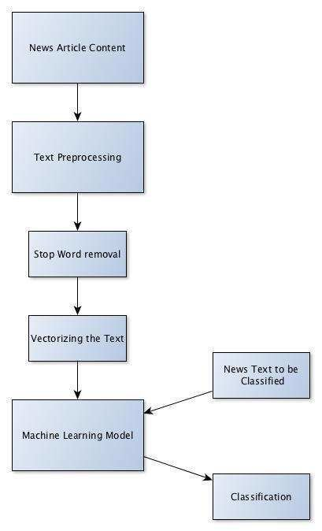

Slide 7
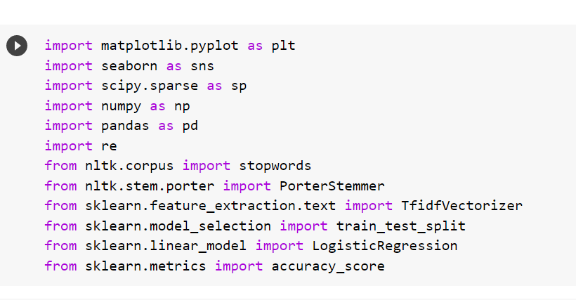
Imported different python libraries like matplotlib, TfidVectrorizer, LogisticRegression, accuracy_score

Slide 8
Data Cleaning

Slide 9
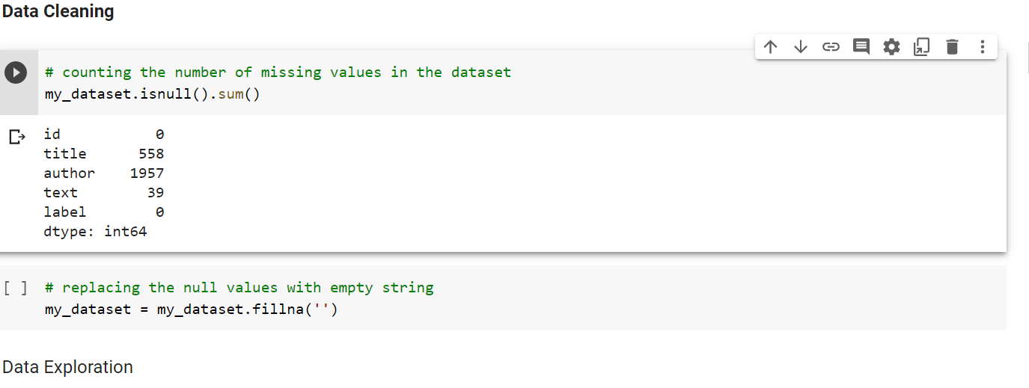
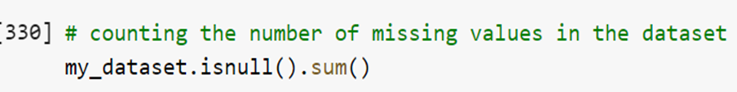

Slide 10
Data Exploration

Slide 11
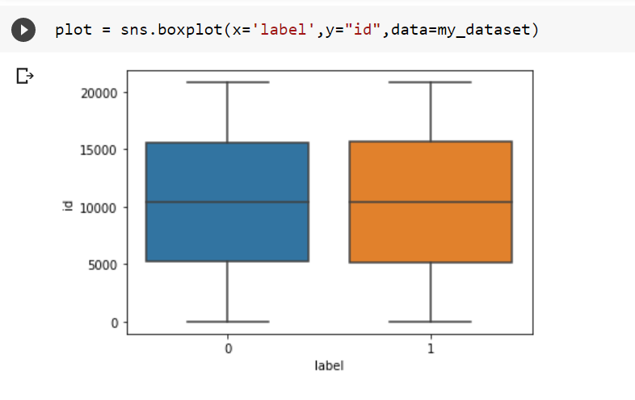

Slide 12
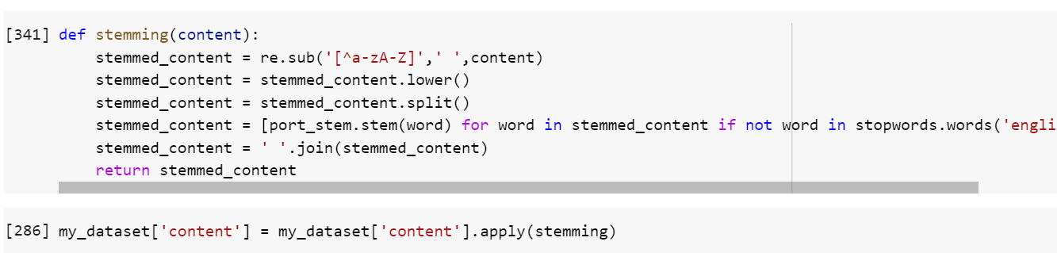
→Stemming is the process of reducing a word to its Root word
example: actor, actress, acting --> act

Slide 13
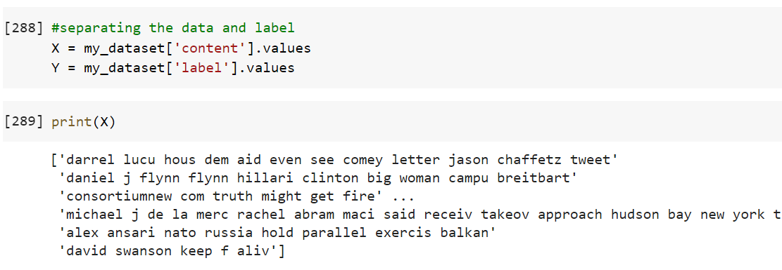

Slide 14
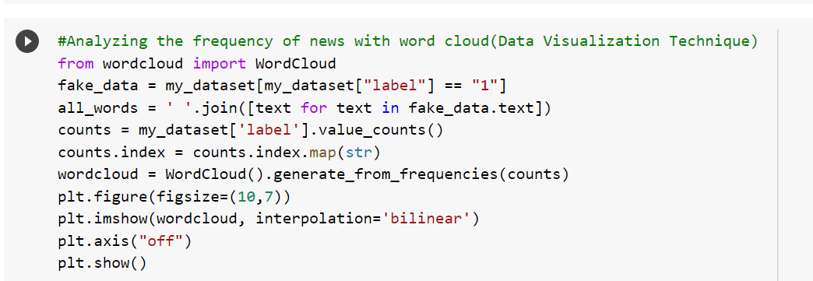

Slide 15
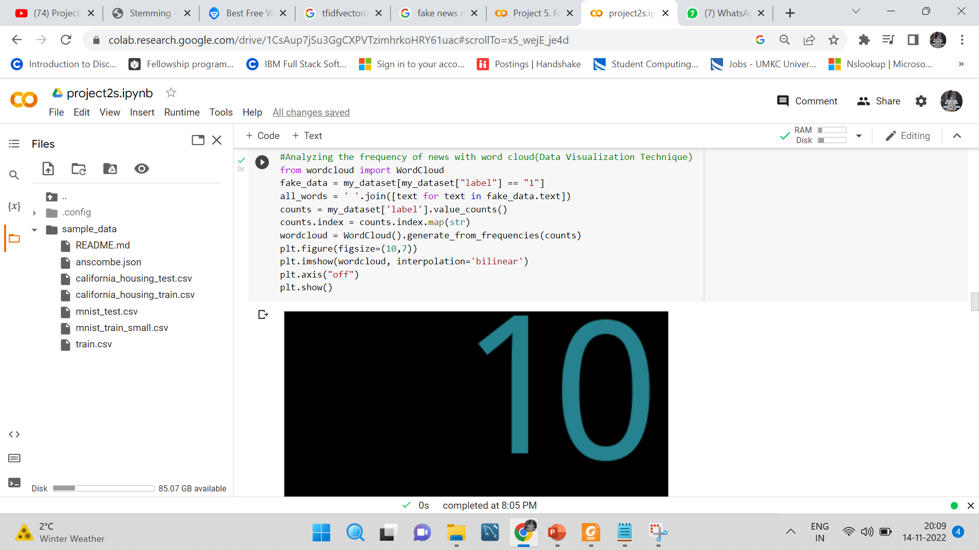

Slide 16
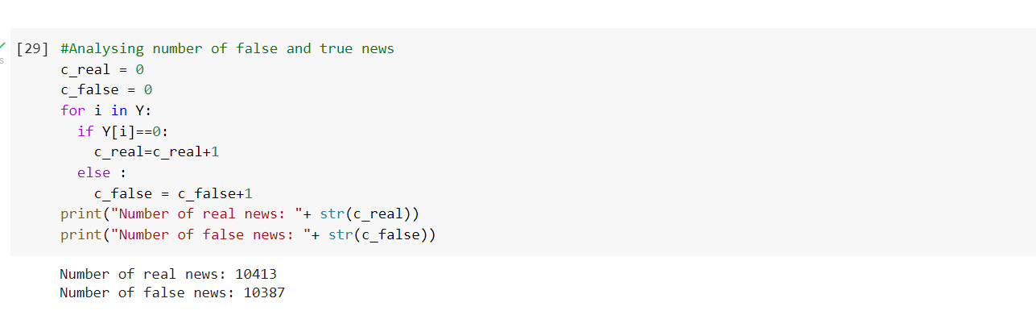

Slide 17
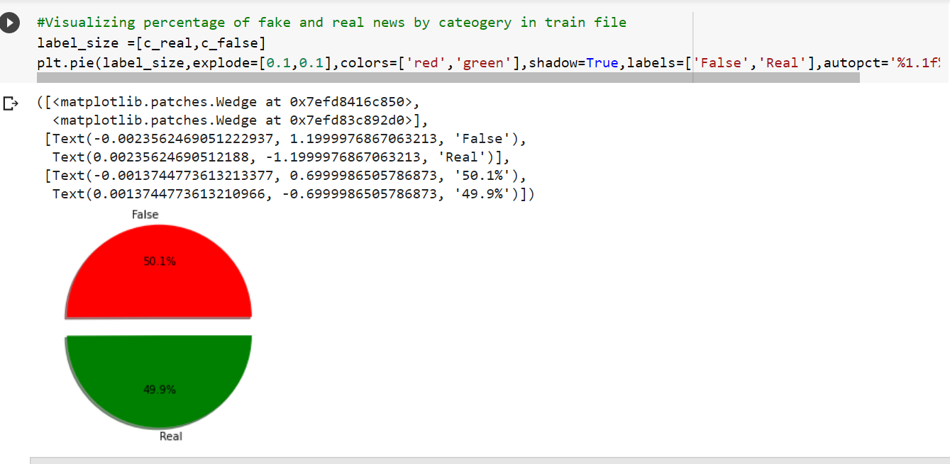

Slide 18
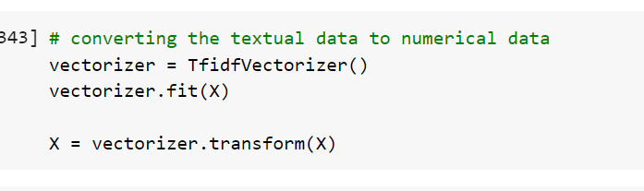
TfidVectorizer

Slide 19
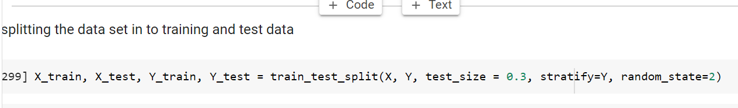

Slide 20
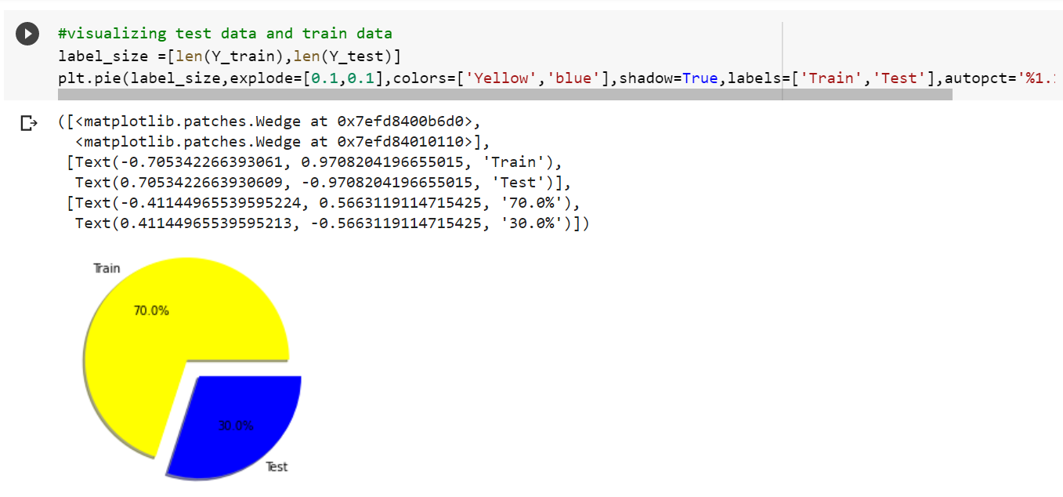

Slide 21
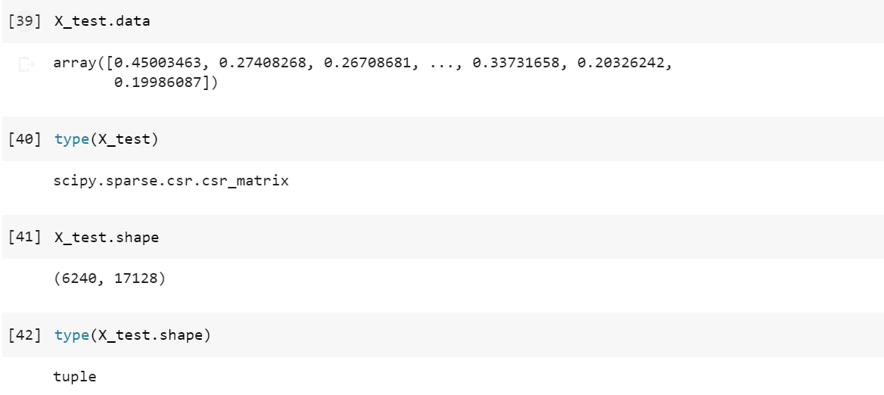

Slide 22
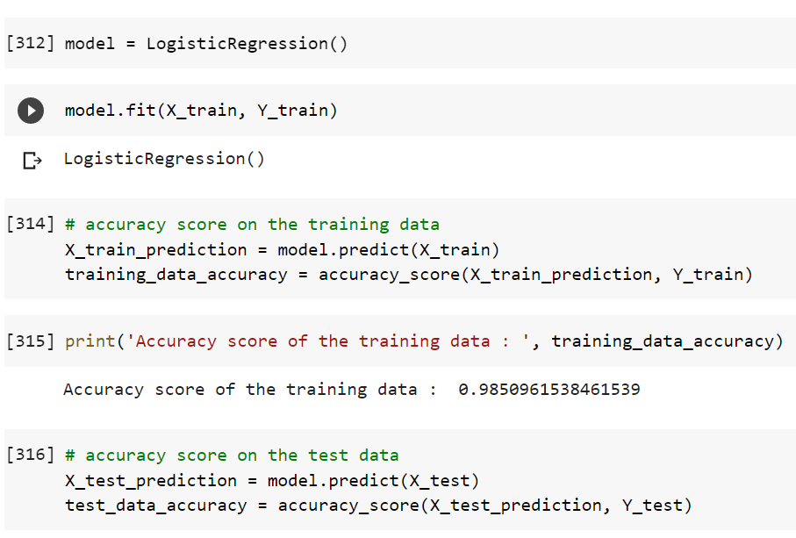
Applying the logistic regression model to train

Slide 23
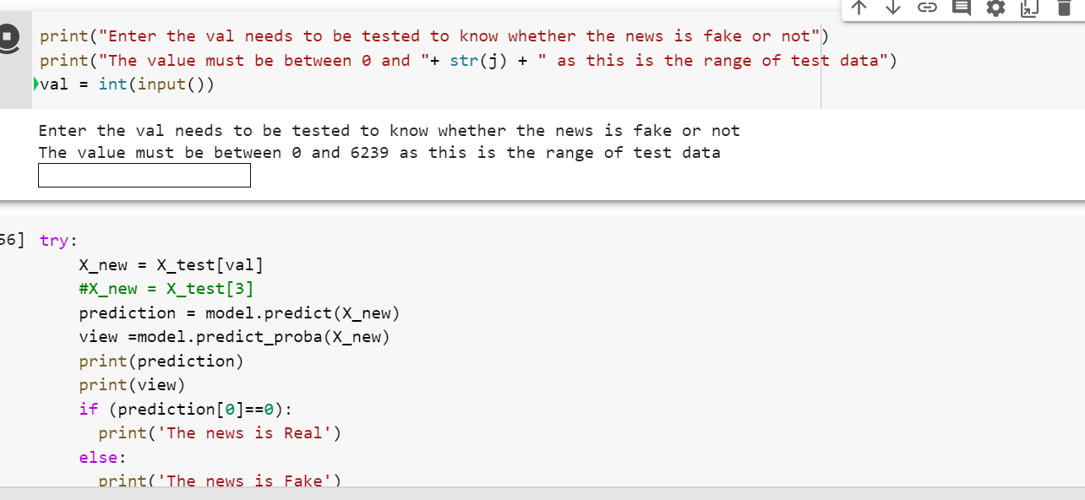
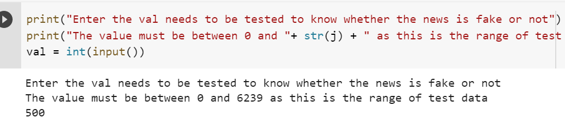
User can select the value from test data
Giving value as 500

Slide 24
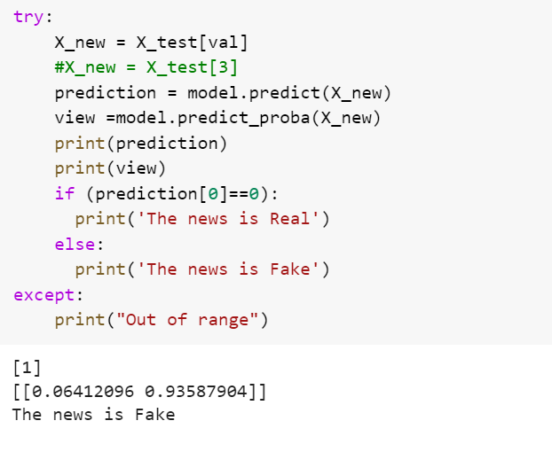
Prediction Method

Slide 25
Thank You

